Slide 1
Chapter 21 Generics

Slide 2
Generics - Overview
Generic Methods specify a set of related methods
Generic classes specify a set of related types
Software reuse with compile-time type safety

Slide 3
What is Generics?
Generics is the capability to parameterize types.
Can define class or method with generic types
Compiler substitutes with concrete types.
Example:
  a generic stack class that stores elements of a generic type.
  Can create stack of strings and stack of numbers.
  String and Number are concrete types.

Slide 4
Generic Methods
Method overloading – can have several identical methods with same number of arguments, but of different types (printArray for Integer, Double, Character)
Can replace with one generic method

Slide 5
Generic Methods
Syntax:
Public static <E> void print (E[] list)
Type parameter section in angle brackets before return type of method
Can be comma separated list.

Slide 6
Generic Methods
public static <E> void print(E[] list) {
for (int i = 0; i < list.length; i++)
System.out.print(list[i] + " ");
System.out.println();
}
public static void print(Object[] list) {
for (int i = 0; i < list.length; i++)
System.out.print(list[i] + " ");
System.out.println();
}

Slide 7
Generic Methods
Generic methods can be defined in ordinary classes.
public class ArrayAlg{
public static <T> T getMiddle(T[] a) {
return a[a.length/2];
}
}

Slide 8
Pre-JDK 1.5
Generics introduced in JDK 1.5
Prior versions of Java used inheritance
Parameters can be of type Object

Slide 9
Why Generics?
What was wrong with using Object?
  Casting is necessary when return value is of general type
  AND
  No error checking - the type of object can keep changing.

Slide 10
Why Generics?
Key benefit: generics enable errors to be detected at compile time rather than at runtime.
With generic class or method, can specify types of objects that the class or method may work with.
Attempt to use class or method with incompatible object -> compilation error.

Slide 11
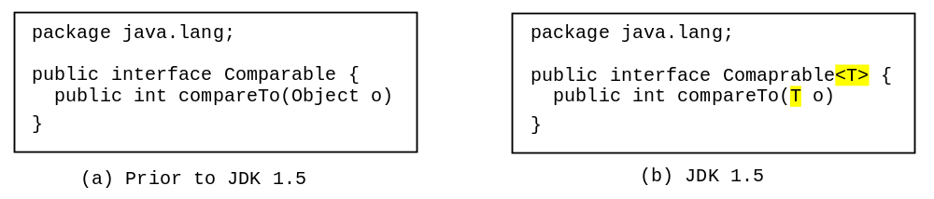
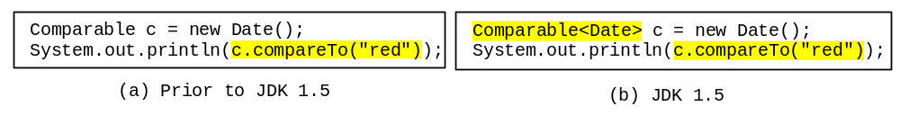
Generic Type
Generic Instantiation
Runtime error
Improves reliability
Compile error

Slide 12
Why Do You Get a Warning?
public class ShowUncheckedWarning {
public static void main(String[] args) {
java.util.ArrayList list =
new java.util.ArrayList();
list.add("Java Programming");
}
}
JDK 1.5 generics. (Types may not be compatible.)

Slide 13
Fix the Warning
public class ShowUncheckedWarning {
public static void main(String[] args) {
java.util.ArrayList<String> list =
new java.util.ArrayList<String>();
list.add("Java Programming");
}
}
`
No compile warning on this line.

Slide 14
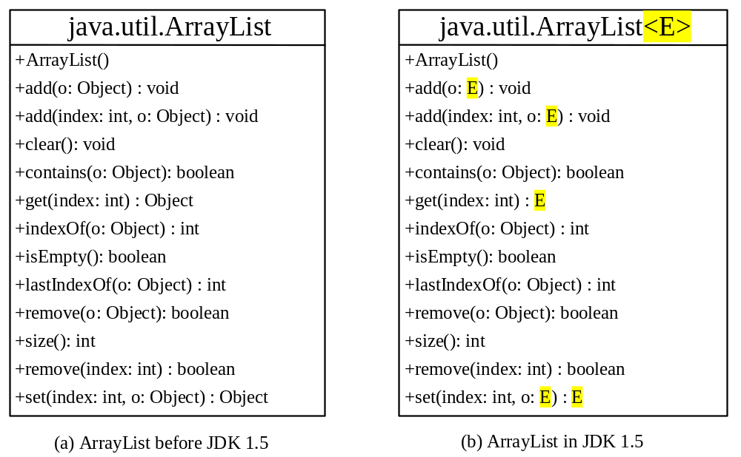
Generic ArrayList in JDK 1.5

Slide 15
No Casting Needed
ArrayList<Double> list = new ArrayList<Double>();
list.add(5.5); // 5.5 is automatically converted to new Double(5.5)
list.add(3.0); // 3.0 is automatically converted to new Double(3.0)
Double doubleObject = list.get(0); // No casting is needed
double d = list.get(1); // Automatically converted to double

Slide 16
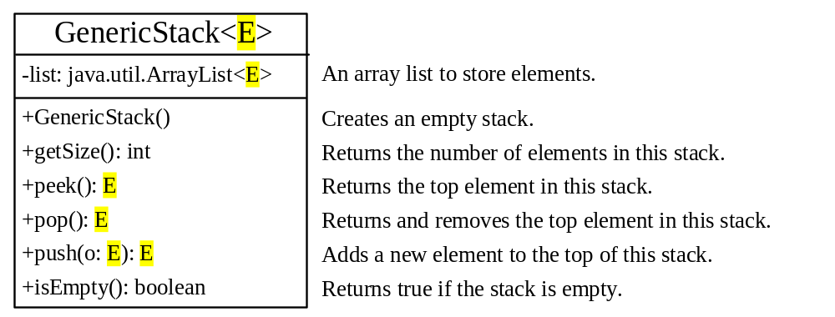
Declaring Generic Classes and Interfaces
GenericStack

Slide 17
Bounded Generic Type
Syntax:
<E extends BoundingType>
Use keyword extends.
Both E and BoundingType can be a class or interface.
Separate several bounds with &
(comma separates type variables)

Slide 18
Bounded Generic Type
public static void main(String[] args ) {
Rectangle rectangle = new Rectangle(2, 2);
Circle9 circle = new Circle9(2);
System.out.println("Same area? " + equalArea(rectangle, circle));
}
public static <E extends GeometricObject> boolean
equalArea(E object1, E object2) {
return object1.getArea() == object2.getArea();
}

Slide 19
C++
C++ templates are like Java generics.
C++ creates multiple copies of code for different possible template instantiations.
Java uses a single, general copy of code

Slide 20
Erasure
Java uses type erasure to create one version of code with a raw type.
Type variables are erased and replaced by their bounding types
What if no bounding types? Object
Cast - method calls that return raw type.

Slide 21
Raw Type and Backward Compatibility
// raw type
ArrayList list = new ArrayList();
This is roughly equivalent to
ArrayList<Object> list = new ArrayList<Object>();

Slide 22
Raw Type is Unsafe
// Max.java: Find a maximum object
public class Max {
/** Return the maximum between two objects */
public static Comparable max(Comparable o1, Comparable o2) {
if (o1.compareTo(o2) > 0)
return o1;
else
return o2;
}
}
Runtime Error:
Max.max("Welcome", 23);

Slide 23
Make it Safe
// Max1.java: Find a maximum object
public class Max1 {
/** Return the maximum between two objects */
public static <E extends Comparable<E>> E max(E o1, E o2) {
if (o1.compareTo(o2) > 0)
return o1;
else
return o2;
}
}
Compile-time Error:
Max.max("Welcome", 23);

Slide 24
Limitations
Primitive types cannot be used for type parameter - use wrapper classes.
Type inquiries (instanceof) yield only the raw types.
Arrays cannot be of generic types. (Use ArrayList to collect generic types.)

Slide 25
Limitations (cont.)
Cannot instantiate generic types.
Error: new E().
Type variables cannot be used in a static context - which type should they be?!

Slide 26
Inheritance
No relationship between Pair<S> and Pair<T>, no matter how S and T are related
Why not?
Code won’t always work
(You can insert Double to ArrayList of Number, not to ArrayList of Integer)

Slide 27
Wildcards
Why wildcards are necessary? See this example.
WildCardDemo1
? unbounded wildcard
? extends T bounded wildcard
? super T lower bound wildcard
WildCardDemo2
WildCardDemo3

Slide 28
Wildcards
? unbounded wildcard
? extends T bounded wildcard
T or any of its subclasses
? super T lower bound wildcard
T or any of its superclasses

Slide 29
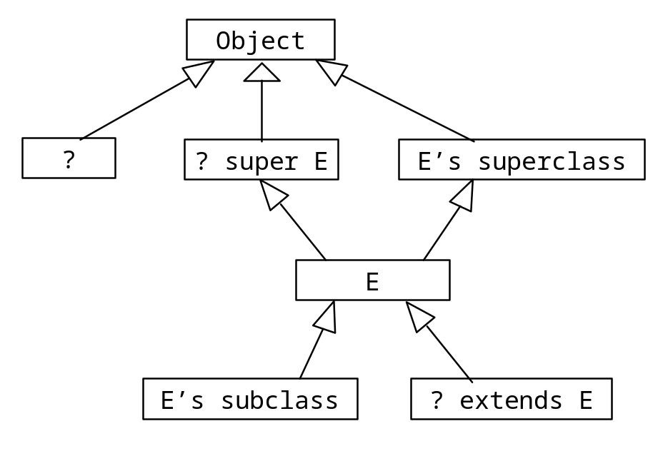
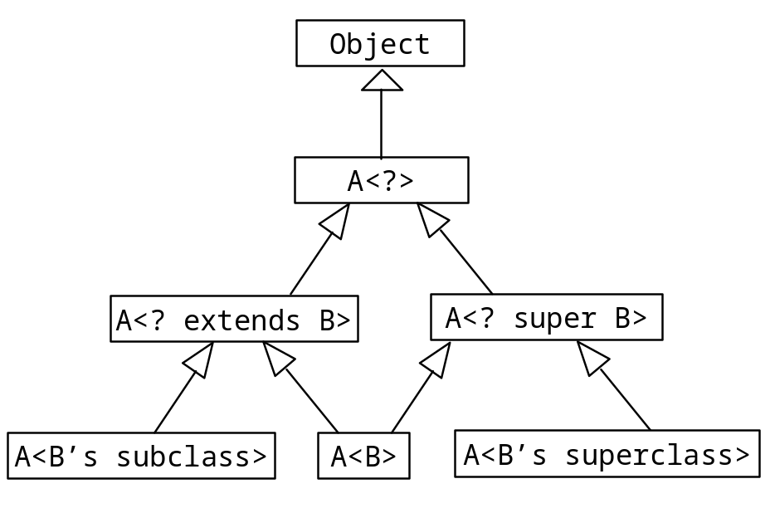
Generic Types and Wildcard Types

Slide 30
Wildcards
Advantage:
Wildcards provide flexibility when passing parameterized types to a method.
Disadvantage:
Cannot be used as type name throughout method body.

Slide 31
Avoiding Unsafe Raw Types
Use
new ArrayList<ConcreteType>()
Instead of
new ArrayList();
TestArrayListNew
Run

Slide 32
Erasure and Restrictions on Generics
Implementation of generics: type erasure.
The compiler uses the generic type information to compile the code, but erases it afterwards.
Generic information is not available at run time.
Backward-compatibility with legacy code that uses raw types.

Slide 33
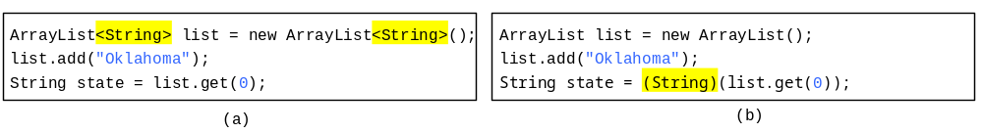
Compile Time Checking
For example, the compiler checks whether generics is used correctly for the following code in (a) and translates it into the equivalent code in (b) for runtime use. The code in (b) uses the raw type.

Slide 34
Important Facts
It is important to note that a generic class is shared by all its instances regardless of its actual generic type.
  GenericStack<String> stack1 = new GenericStack<String>();
  GenericStack<Integer> stack2 = new GenericStack<Integer>();
Although GenericStack<String> and GenericStack<Integer> are two types, there is only one class GenericStack loaded into the JVM.

Slide 35
Designing Generic Matrix Classes
Objective: This example gives a generic class for matrix arithmetic. This class implements matrix addition and multiplication common for all types of matrices.
GenericMatrix

Slide 36
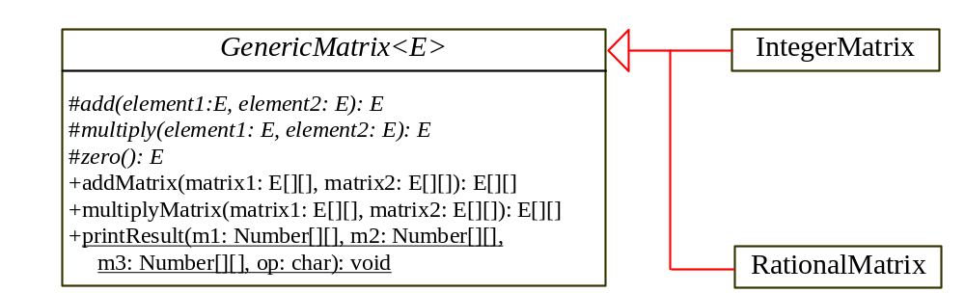
UML Diagram

